Slide 1

Data Analytics (SQL-Based)
Calculating sales with the queries of SQL

Slide 2
DESCRIPTION:-
This project, provided by Elevate Lab, focuses on analyzing online sales data to uncover key business insights. The dataset includes columns such as Order Date, Product ID, and Amount, which allow for detailed analysis of customer purchase behavior over time.
The main objectives of the project include:
Extracting and grouping sales data by month and year.
Calculating total revenue using aggregate SQL functions.
Identifying sales trends across different periods and products.
Optimizing SQL queries to improve performance and scalability.
By leveraging SQL queries such as EXTRACT(MONTH FROM order_date), SUM(amount), and GROUP BY, the project demonstrates practical skills in data aggregation, date-time manipulation, and business intelligence reporting.

Slide 3
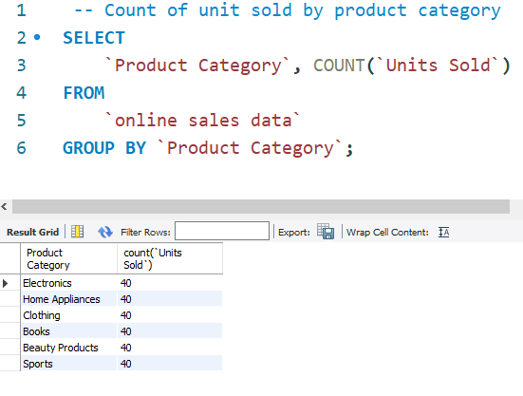
Count of unit sold by Product Category:-

Slide 4
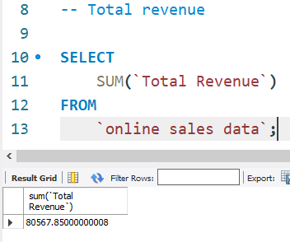
Total Revenue:-

Slide 5
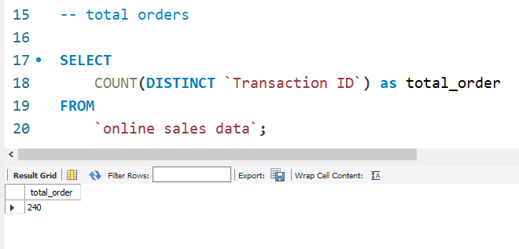
Total Orders:-

Slide 6
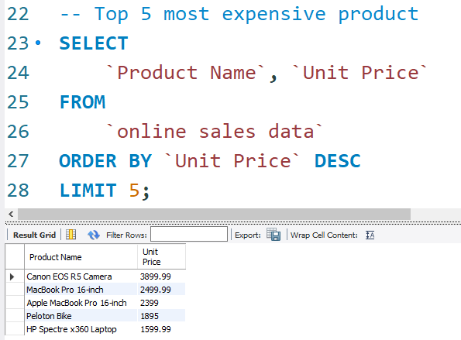
Top 5 Most Expensive Products:-

Slide 7
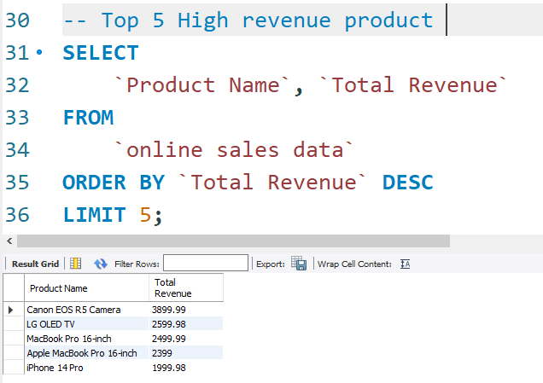
Top 5 High Revenue Product:-

Slide 8
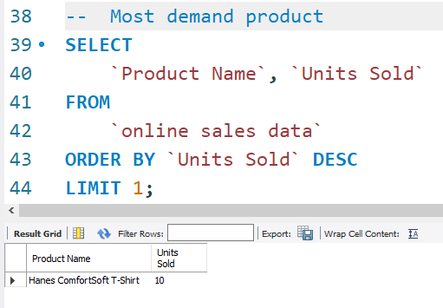
Most Demanding Product:-

Slide 9
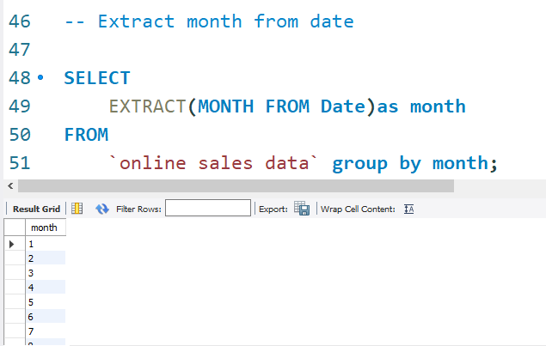
Extract Month From Date:-

Slide 10
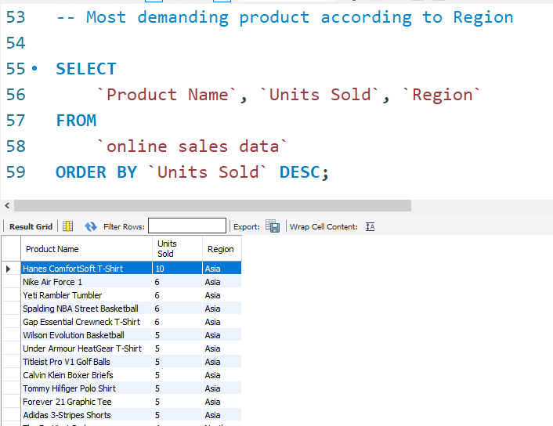
Most Demanding Product by Region

Slide 11


